Slide 1
Meeting Strategy Planning and Breakout Session

Slide 2
Structure of a Successful Congressional Meeting [see your Congressional Meeting Road Map for details]
Opening
Transition to the Issues
Soundbites, Stats, Stories
Making the “ask”
Thank you and follow-up

Slide 3
Your Breakout Session (~40 mins) Assignments:
Segment #1 – Assign roles and practice the opening (~15 mins)
Segment #2 – Practice sharing soundbites, stats & stories (~10 mins)
Segment #3 – Make the “ask”, thank you, and follow-up (~12 mins)

Slide 4
Breakout Segment #1: Determine Roles and Practice Making the Opening (~15 mins)
Roles to Consider:
Team Captain
Scribe/Notetaker (this person should complete the meeting feedback report--TBD)
Statistician
Storyteller
“Ask-maker”
Timekeeper
Put-links-in-chat-er
The Opening: (Finding Common Ground)
Reference NAFSA affiliation
Offer special thanks as appropriate (will be provided under ‘talking points’ in online meeting portal--TBD)
Did they study abroad?
Which part of the state are they from?
Any connection to your university?

Slide 5
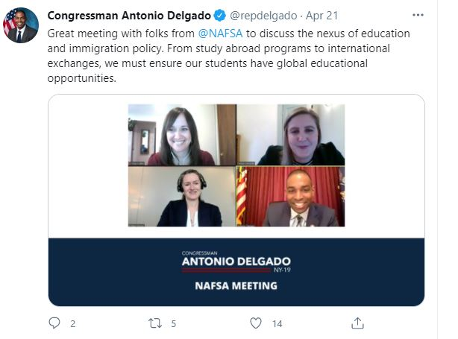
Breakout Segment #2: Practice Sharing Soundbites, Stats, and Stories (~10 mins)
Transition to the Issues:
Soundbites (your “Meeting Road Map” document)
Statistics/Data and Stories
NAFSA International Student Economic Value Tool data for your state/congressional district
State-by-State Study Abroad Participation Data

Slide 6
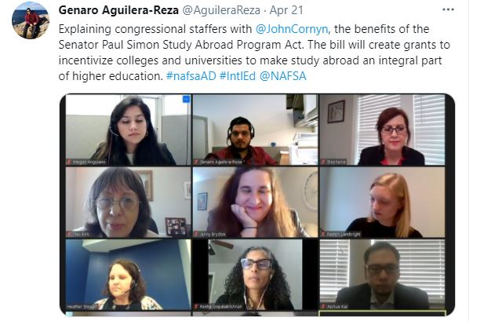
Breakout Segment #3: Making the “Asks” (~12 mins)
How the Lawmaker Can Help
Congressional Meeting Road Map
Talking Points in Online Portal
Issue Briefs (“leave behind” materials for congressional offices)
How You Will Follow Up

